Slide 1
The Amazing Race
To CIVILIZATION

Slide 2
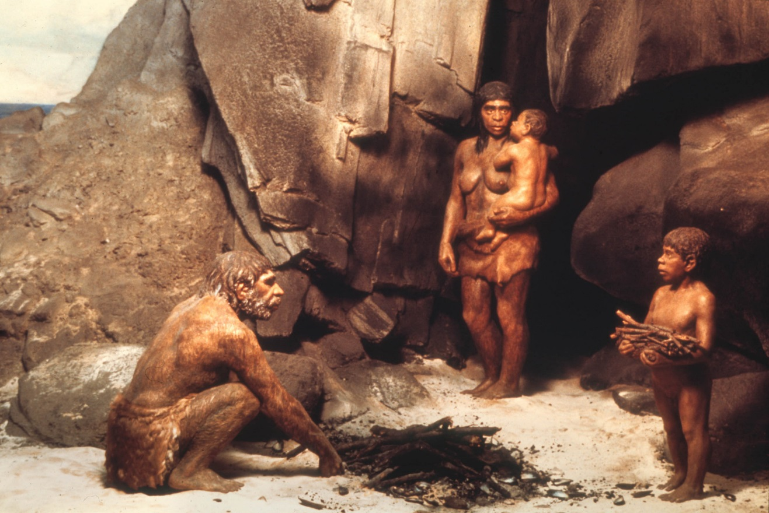
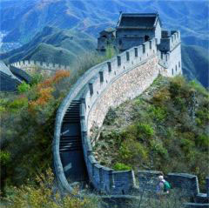
Created By Mr. Wardman

Slide 3
THE RULES
1. NEVER, EVER mess with the route, do not cheat.
2. KEEP all clues. Bring them to check-in.
3. Return all supplies, envelops, etc. if asked before you go to the next task.
4. Complete the reflection questions (may carry into next day).

Slide 4
6 Teams…
Majid, Sterling, Isis, Taya
Reina, Kendra, Keagan, Rocco
Elora, Dylan, Lauren, Tyler
Grace, Tyler, Kalie, Tanner
Miles, Madison, Caydence, Brayden
Sally, Chase, Sheyenne, Gavin

Slide 5
Contestant – ON YOUR MARKS
ASSEMBLE YOUR TEAM AND LINE UP FOR YOUR FIRST TASK. After completing this task, you will get your ticket.

Slide 6
CONGRATULATIONS
YOU HAVE COMPLETED THE FIRST LEG OF THE AMAZING RACE TO COLONIZATION
REFLECTIONS:
How well did your group work together, explain why you feel that way?
Did you rely on someone in particular or was work shared equally?
Give examples of how you overcame challenges through learning, collaborating, innovating or thinking.
What would you adapt if you had to do it again?

